Slide 1
LUNAR EXPLORATION
Matthew Katterman

Slide 2
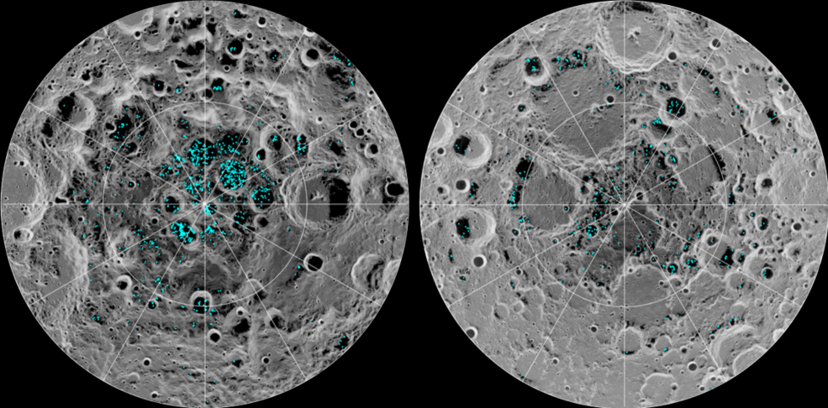
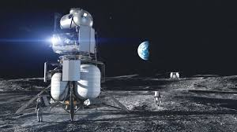
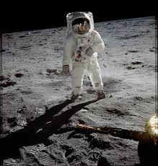

Artemis Mission (Exploration of the Moon)
First Man and Woman on the Moon in 2024
Artemis Missions
(2021 – 2029)
Scientific Exploration
(South Pole of Moon)
Human Habitat Exploration

Slide 3


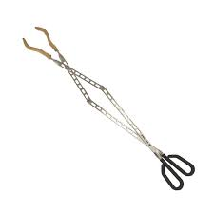
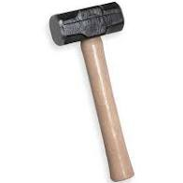

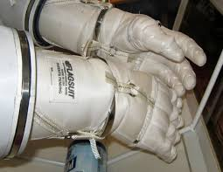
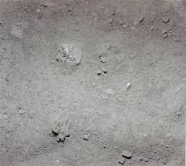
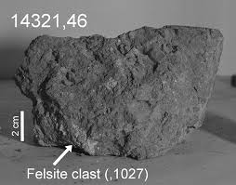
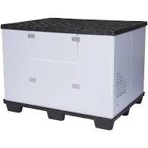


Exploration Tools for Astronauts
Extreme cold & Gripping
Lunar Soil
Moon Rocks
Bags, containers
Core tubes
Contain volatiles
Preserve ice/rock

Slide 4
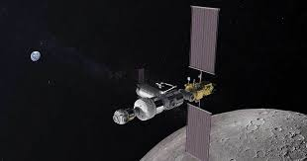
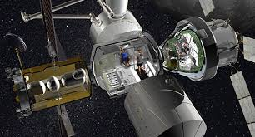
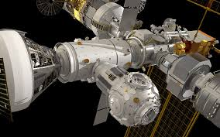
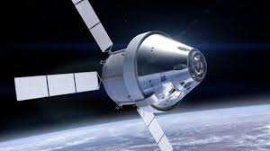
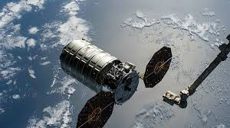
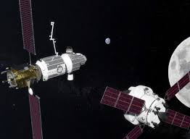
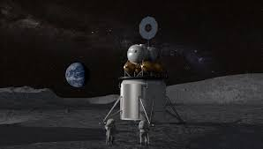
Gateway Space Station
Outpost orbiting the moon
Human habitation for astronaut crew
Docking ports for some spacecraft
Orion Spacecraft
Cargo Spacecraft
Spacecraft to Mars
Human Landing Systems

Slide 5
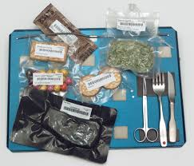
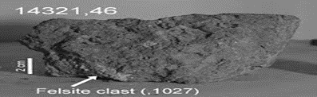

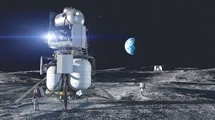
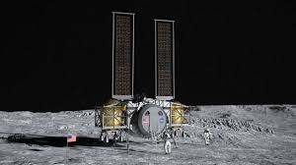
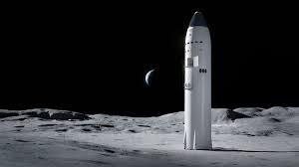
Human Landing Systems
Carries crew, supplies (food, tools), samples back and forth from the moon to Gateway.
Docks with Gateway or Orion
Lands spacecraft on the moon
BLUE ORIGIN TEAM
DYNETICS TEAM
SPACE X TEAM –
Cargo and Supplies

Slide 6
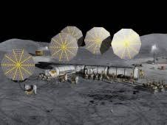
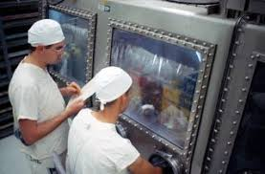
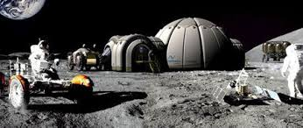






Lunar Outpost or Base
Establish small moon colony
(2028)
Examine & Experiment with soil samples
Sustainable Lunar
Exploration Program
Temporary job
(Days to weeks)
Contract job
(Weeks to months)
Permanent job
(Months to years)

Slide 7
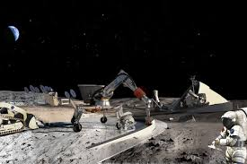
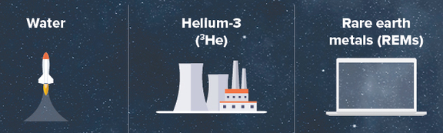
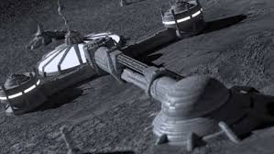

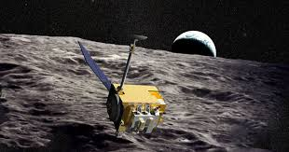
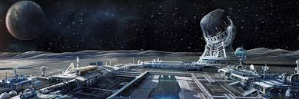
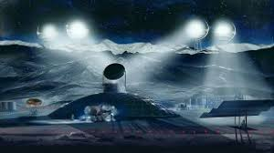
Plans for future moon colonies
Colonies would be primarily for mining purposes
Water – rocket fuel, life support
REMs – Electronic devices
Helium-3 – Electricity from Fusion
Importance of 3D Printed Habitats, Robots for work & mining
Lunar orbiters – find suitable locations to land, mine, live
Moon Village Association 2017
Projects for sustainable presence on the moon – Space Economy
Water – fuel cell power, creates oxygen, needed for colony survival

Slide 8
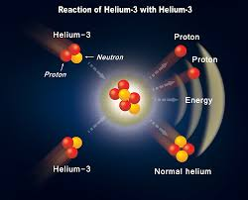
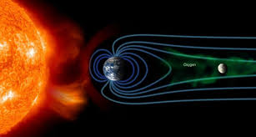
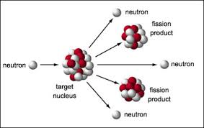

Mining Helium 3 for Energy
Helium 3 – Helium isotope that can combine with deuterium or itself to create energy through nuclear fusion.
Creates clean, non-radioactive electrical energy directly from fusion.
Element from solar wind deposited on surface.
There is over 100 million tons of it on the moon.
Could provide enough energy for centuries.
Could be a multi-billion dollar industry

